Slide 1
AUTOMATIC WATERING SYSTEM FOR PLANTS
SUBMITTED BY,
SREELAKSHMI KRISHNANKUTTY – C0765644
GROUP - 6

Slide 2

INTERFACING OF LIGHT SENSOR WITH BEAGLEBONE BLACK

Slide 3
LDR INTERFACING WITH BEAGLEBONE BLACK
Here we are using a photoresistor to measure light with a Beaglebone Black.
There are many ways in which a Beaglebone black can be programmed.
Here we are using python to read analog values with a photoresistor light sensor.
Later we access the values using a c file.

Slide 4
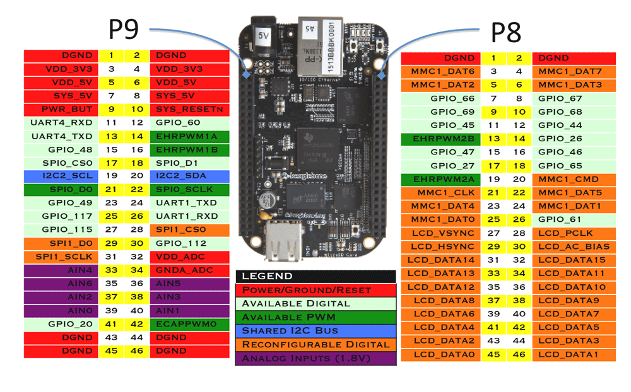
COMPONENTS REQUIRED
Beaglebone black
The BeagleBone Black is unique in that it has a large number of pins that can be accessed through simple pin headers, as well as being a fairly powerful device.

Slide 5
COMPONENTS REQUIRED
Some of the functionality that is available:
7 Analog pins
65 Digital Pins at 3.3V
2x I2C
2x SPI
2x CAN Bus
4 Timers
4x UART
8x PWM
A/D Converter

Slide 6
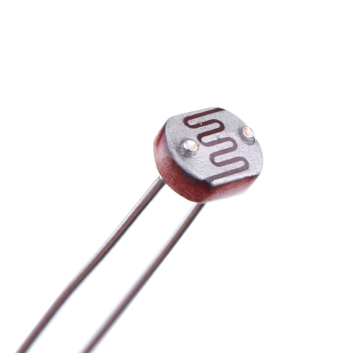
COMPONENTS REQUIRED
PHOTO RESISTOR
The photoresistor used has a dark resistance in excess of 200 kΩ and under bright light, the resistance falls to 1 or 2 kΩ.

Slide 7
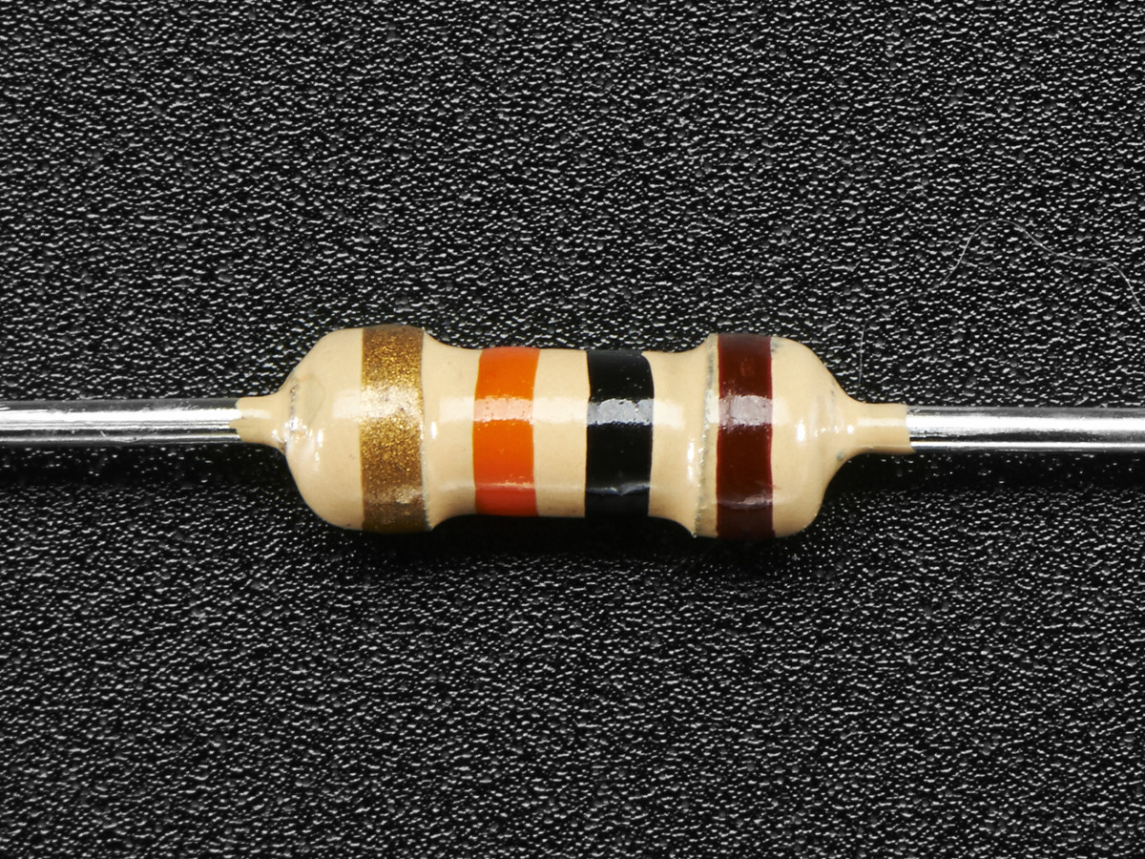
COMPONENTS REQUIRED
Resistor 10 kΩ (Brown, Black, Orange, Gold)

Slide 8
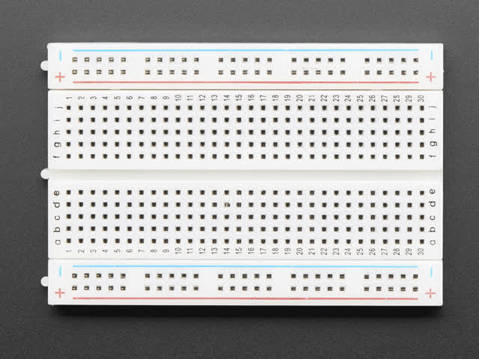
COMPONENTS REQUIRED
Half sized bread board

Slide 9
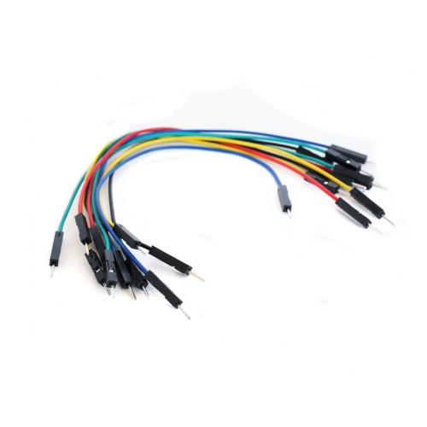
COMPONENTS REQUIRED
Male to male jumper wires

Slide 10
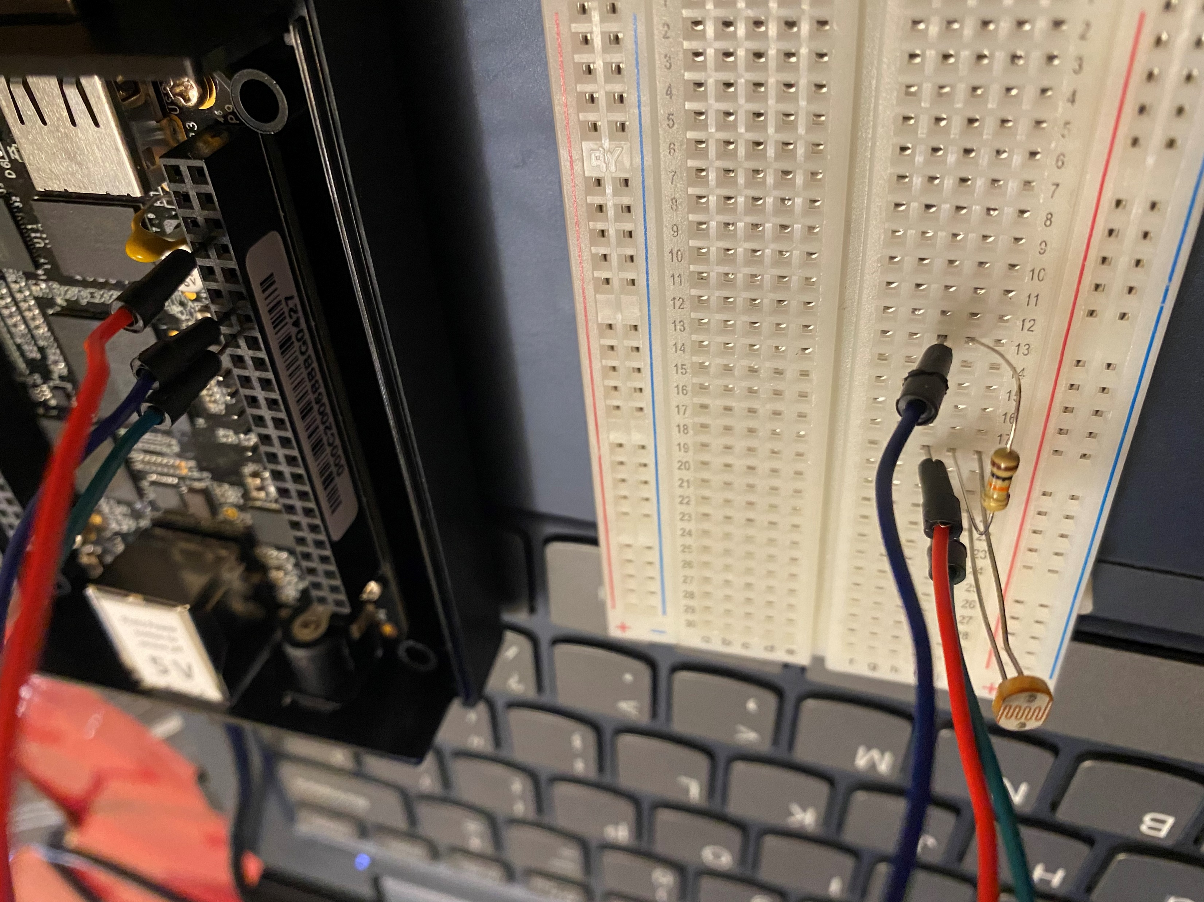
WIRING
Both the photoresistor and the resistor can be placed either way around. They are arranged in a way called "voltage divider" arrangement.

Slide 11
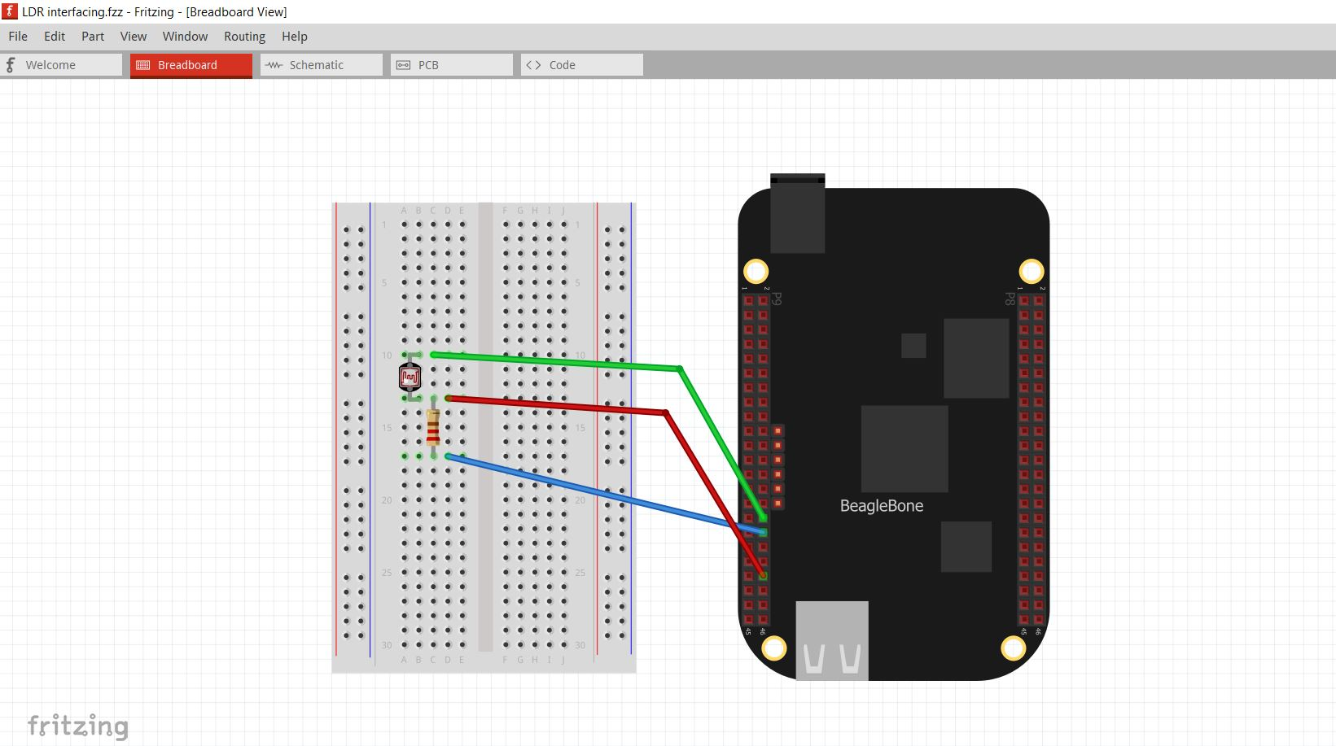
WIRING
Image of connection diagram created using fritzing software

Slide 12
WIRING
The red wire is connected to pin 40 of P9, which is also analog input 1 (AIN1)
The blue wire is connected to the pin 34 of P9, which is the ground and the other end is connected to the bottom of the resistor.
The green wire is connected to pin 32 of P9, which is VDD and the other end is connected to the top connection of photoresistor.

Slide 13
LDR CIRCUIT
The photocell used is of a type photoresistor sometimes called LDR- Light dependent resistor.
These components work similarly to resistors, with the exception that the resistance varies in response to the amount of light falling on them.
The photoresistor used has a dark resistance in excess of 200 kΩ and under bright light, the resistance falls to 1 or 2 kΩ.
To convert this varying value of resistance into something we can measure on BBB's analog input, it need to be converted into a voltage between 0 and 1.8V.

Slide 14
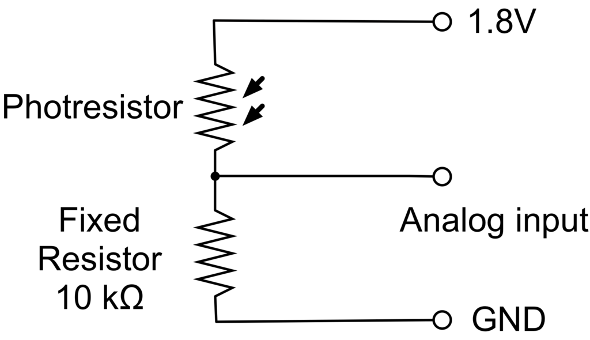
LDR CIRCUIT
The simplest way to do that is to combine it with a fixed resistor, in this case of 10 kΩ in an arrangement called a voltage divider.

Slide 15
LDR CIRCUIT
The voltage at the analog input will be pulled up towards 1.8V by the photoresistor and down towards 0V by the fixed resistor.

Slide 16
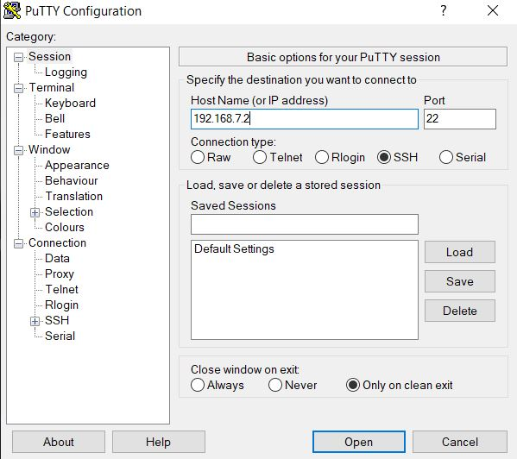
CONNECTING BEAGLEBONE BLACK VIA PUTTY SOFTWARE
Power the beaglebone black
SSH with windows and putty
Enter the IP address 192.168.7.2 and click ‘Open’.

Slide 17
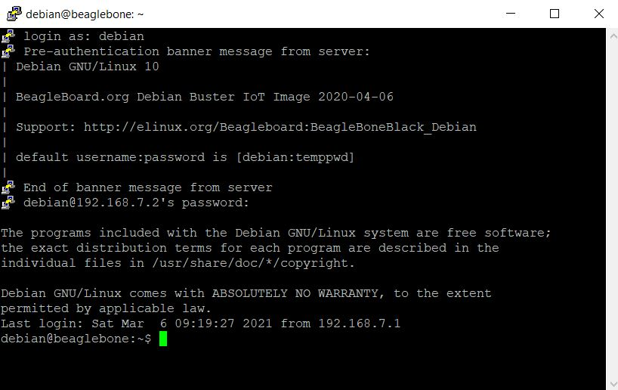
CONNECTING BEAGLEBONE BLACK VIA PUTTY SOFTWARE
After opening the PUTTY window, we have to login as Debian and then enter the password.

Slide 18
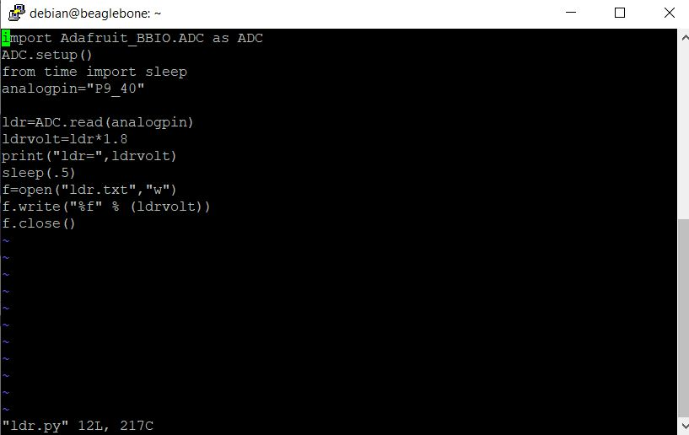
CREATING THE CODE MODULE
By using the command vim.tiny ldr.py we create the file and then we write the code.

Slide 19
CODE EXPLANATION
import Adafruit_BBIO.ADC as ADC // We are importing the ADC library.
ADC.setup() //we are initialising ADC
from time import sleep //importing library setup delay
analogpin="P9_40“ //assigning the pin number
ldr=ADC.read(analogpin) //ADC.read function is used to read the ADC value in the analog pin. It is stored to the variable ldr.
ldrvolt=ldr*1.8 //value * reference voltage is the correct voltage
print("ldr=",ldrvolt) // to display the voltage
sleep(.5) //to generate a delay of .5 seconds

Slide 20
CODE EXPLANATION
f=open("ldr.txt","w") //Here we are transferring the value that we are getting from the ldr to a file inorder to access it by C. Here we have two arguments. First is the file name and second is its attribute, ie, to write (w).
f.write("%f" % (ldrvolt)) //to write the ldr value we are getting to the file
f.close() //to close the file after writing

Slide 21
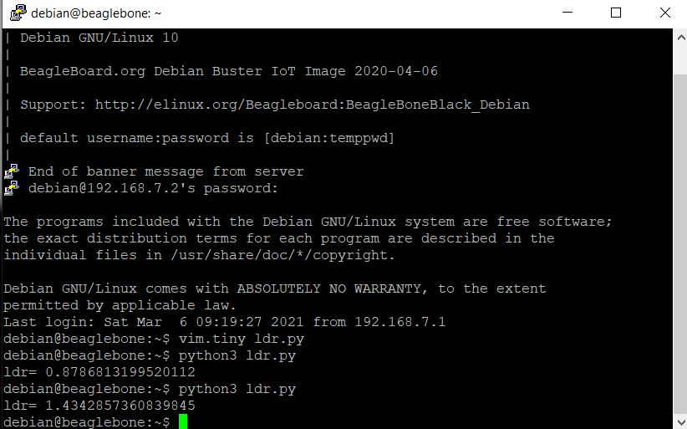
OUTPUT
To run this code we are using the command python3 ldr.py
The first output is in the normal light .
The second value is got when we give a flash light to the LDR.

Slide 22
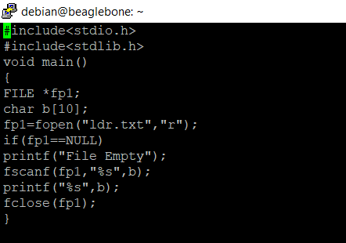
CREATING THE C FILE

Slide 23
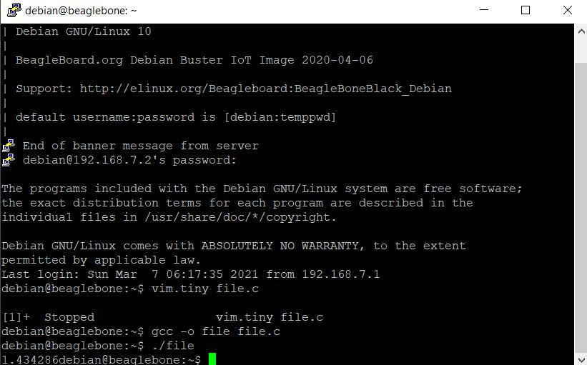
OUTPUT OF THE C FILE
After running file.c code the output we get is as follows.
We get the last read value of the ldr sensor.

Slide 24
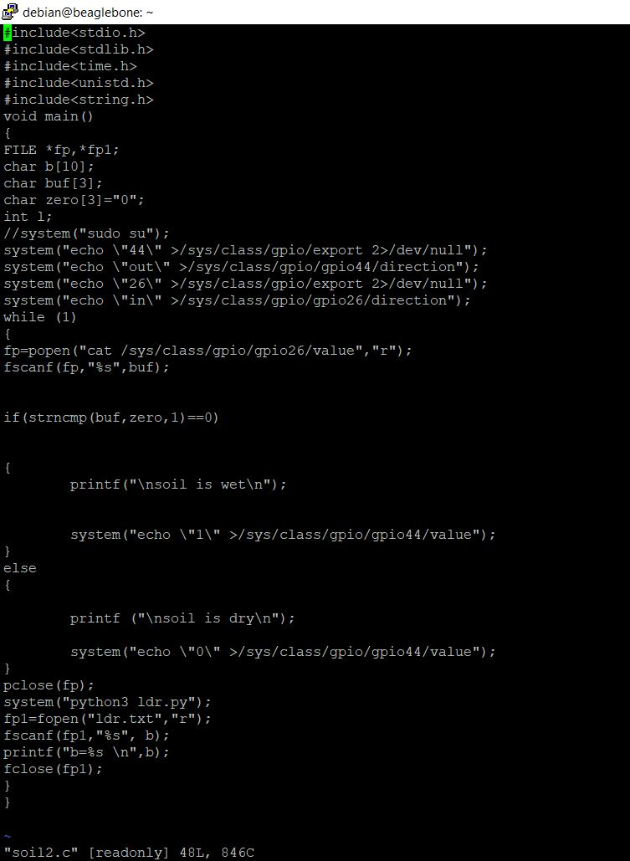
ADDITION OF FEW MORE STEPS TO THE SOIL MOISTURE SENSOR CODE
We have added an additional pointer *fp1 and a character array b[10].
Python module is called by using the function system(“python3 ldr.py”); and then the python code will start running and the value of ldr will be stored in the ldr.txt file.
fp1=fopen(“ldr.txt”, “r”) this function opens ldr.txt file and the behavior given is r ir, read operations. So the read value will be stored to the pointer fp1.
fscanf(fp1, “%s”,b) the value in fp1 will be then stored to the character array b.

Slide 25
ADDITION OF FEW MORE STEPS TO THE SOIL MOISTURE SENSOR CODE
Printf(“b=%s \n”,b) the value in b will be printed
Fclose(fp1) it is used to close the file

Slide 26
FINAL RESULT
We get continuous output when we run this code with the value of ldr that we get by running the python code and then we get the value of b, which we access with the c file from the python code.

Slide 27
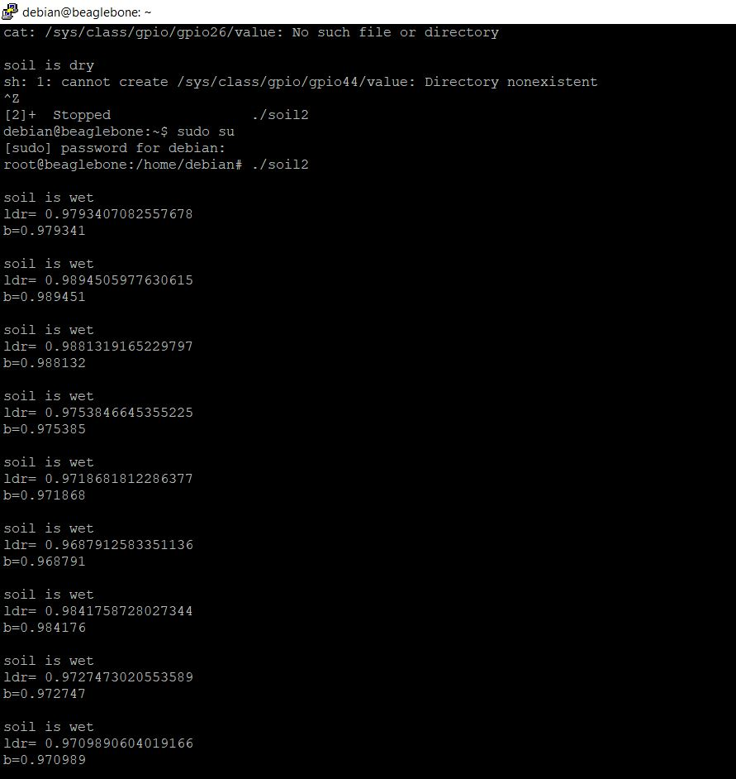
OUTPUT
The output we get in normal light.

Slide 28
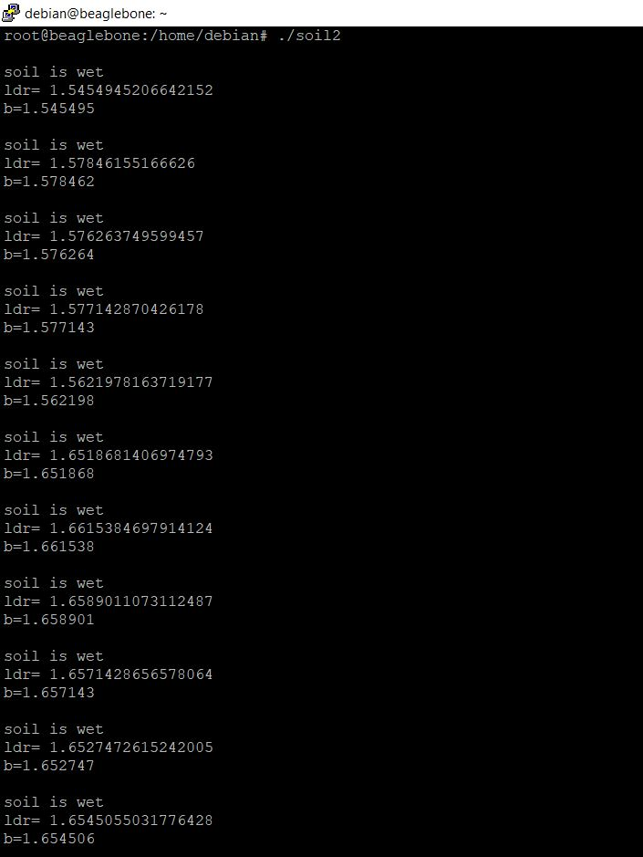
OUTPUT
The output when we apply an external flash light to the ldr.

Slide 29
REFERENCES
LDR Interfacing : https://learn.adafruit.com/measuring-light-with-a-beaglebone-black/photoresistors
Beaglebone Black : https://learn.adafruit.com/setting-up-io-python-library-on-beaglebone-black
Photoresistor : https://learn.adafruit.com/measuring-light-with-a-beaglebone-black/photoresistors

Slide 30
REFERENCES
Extending python with C : https://docs.python.org/3/extending/extending.html
LDR Circuit : https://learn.adafruit.com/measuring-light-with-a-beaglebone-black/photoresistors
Setting up python library : https://learn.adafruit.com/setting-up-io-python-library-on-beaglebone-black/adc

Slide 31
THANKYOU

